Slide 1
ERM – WBG – KBANK China
Retail Lending Special Project
ERM CN Retail RISK Capability

Slide 2
Background: KBANK CN 5-Year Business Aspiration
Retail Business Strategic Projection
We Are Here
Stage I: Build & Learn
Stage II: Acquire & Connect
Stage III: Scale Up & BAAS
2020-2021Y
2022-2023Y
2024Y Onwards
2019
Existing Projects
Project Pipeline 2020-2021
WCD1
Auto Loans
500 MRMB
Auto Loans
PAOC1
CUP
WCD3
With Fallback
With Fallback
Internet Loans Co-Lending With Fallback/Wo Fallback
Edu Loans
PAOC2
…
…
Retail Lending Projects
2020
With Fallback
WCD2
Auto Loans
100 (E) MRMB
Personal Cons.
AI2
…
…
No Fallback
BM1
Better ME Edu POC
With Fallback
AI1
Personal Cons.
300 (E) MRMB
No Fallback
…
…
…
…
With Fallback
…

Slide 3
Online Lending Regulatory Requirement
商业银行互联网贷款管理暂行办法 | Interim Measures for Administration of Internet Loans Issued by Commercial Banks issued by CBIRC Effective date: 2020-07-12
Stage I: Build & Learn
Article 21: Credit Approval | Commercial banks should establish effective risk assessment, credit approval and risk pricing models, strengthen unified credit management, use risk data, and prudently evaluate the borrower's repayment ability in combination with the borrower's existing debt situation, and determine the borrower's credit rating and credit line.
Article 22: Manual Approval Intervention | A commercial bank shall establish a manual rechecking and validation mechanism as a necessary supplement to the automatic approval of risk models, clarify the conditions for triggering manual rechecking and validation, and reasonably set the operational procedures for manual rechecking and validation.
Article 29: Risk monitoring and alert model | A commercial bank shall, through establishing a risk monitoring and early warning model, monitor the status of borrowers' finance, credit and business, etc., set reasonable early warning indicators and early warning triggering conditions, send out early warning signals without delay and take manual verification as a supplementary means where necessary.
Article 32: Collection Strategy | When Internet loans become non-performing, commercial banks should formulate differentiated collection and disposal strategy in a timely manner according to their features to improve collection and disposal efficiency.
Article 49: Counter Party Assessment | Article 49 A commercial bank shall establish a unified access mechanism covering all types of cooperative institutions, clarify corresponding standards and procedures and implement list management.
Pre-Lending
Credit Approval
Impact
Credit
Monitoring &
Provisioning
Risk Capability Readiness for Internet Loans
Risk Capability
Collection
Asset Quality Management
Model Risk Management

Slide 4
KBANK China – ERM CN Risk Capabilities
CO/SOLO-Lending with Fallback
SOLO-Lending without Fallback
Stage I: Build & Learn
Stage II: Acquire & Connect
Stage III: Scale Up & BAAS
2020-2021Y
2022-2023Y
2024Y Onwards
Pre-Lending
Partnership Evaluation
Analytics Engine
Qualitative
Quantitative
Credit Forum
Online Risk Engine
Monthly Analytics Engine
Daily Analytics Engine
Credit Approval
Risk Rules (Credit Policy)
External Data
Application Score
Pricing
Limit Assignment
Collateral Valuation
A-Score
B-Score
C-Score
Data & Credit Models
PAOC
WISECO
Income
Classifi.
Collection Strategy.
Income Estimation
Debt Estimation
Debt
EW
Credit
Monitoring &
Provisioning
Behavioral Score
Early Warning
Portfolio Conc.
Stress Testing// Risk Limits & Appetite
CUPD
BAIRONG
Datalake EBAN
Provisioning
Risk Capability
Securiti-ation
Internal Credit Grading
RAROC
Credit Review
Roll Rate & Vintages
Collection
Collection Management
Client Communication
Reporting
Model Lifecycle Mngmt
&
Validation
Collection Workflow Mngmt
Collection Score
Collection Strategy
Client Comm.
SMS
WeChat
Collection Monitoring
Collection Action
Automated Caller
Outsource
Asset Quality Management
Litigation
Liquidation
Collectors
Asset Tracking & Seizure
Model Risk Management
Model Risk & Life Cycle Management
Visual
Analytics
Monitoring
Validation
Calibration
Reporting
Lawfirm
AMC
Credit Process
Internal Capabilities
External Capabilities
Risk Infrastructure
Currently in Development
Not Started

Slide 5
Retail Lending Risk Analytics
Credit Process – 4 Main Phases
0
1
2
3
Pre-Lending
Origination
Credit Management & Monitoring
Collection & Recovery
Freq | Phases | Decision |  | Related Analytics |  | Auto | Edu | Pers
Adhoc | Pre-lending | Business viability, should we start business with this partner? Is the guarantee company strong enough to cover our expected loss? What is the ECL? | 1 | Quantitative Framework For Retail Project Evaluation | Agenda 0: (2 min) [Approval] KBANK CN Model Risk Gov. Structure | Agenda 1: (5 min) [ACK] Quantitative Framework for Retail Lending Project Evaluation |  |  | Agenda 4: (3 min) [ACK] Risk Infrastructure
Online | Origination | Should we grant credit to this customer? What should be the credit limit? What should be the pricing? | 1 | Application Score |  | Completed (May-MVWG) | Completed (Aug-MVWG) | Agenda 2: (5 min) [ACK] Approval Criteria for Personal Cons. Loan
 |  |  | 2 | Income Estimation
 |  |  | 3 | Debt Estimation
 |  |  | 4 | Risk Pricing
 |  |  | 5 | Limit Assignment
Monthly | Credit Management & Portfolio Monitoring | Portfolio risk level? (ECL & Provisioning) Portfolio Concentration? Implications to approval criteria? Securitization? What if…? | 1 | Retail Customer Credit Rating |  | Agenda 3: (5 min) [ACK] Portfolio Monitoring Analytics
 |  |  | 2 | DLQ (Delinquency) Class
 |  |  | 3 | Credit Review & Early Warning Model
 |  |  | 4 | Behavioral Score |  |  | Not Started | In Progress
Daily | Collection & Recovery | Who has DPD? Who to collect? How to collect? When to collect? Did you successfully collect? Implications to collection strategy? | 1 | Collection Model (Rules) |  | Not Started
 |  |  | 2 | Collection Strategy |  | In Progress
 |  |  | 3 | Best Contact Methods, Best Time to Call |  | Not Started
 |  |  | 4 | Recovery Models |  | Not Started
0
1
2
3

Slide 6
ERM – WBG – KBANK China
Retail Lending Special Project
Agenda 0: KBANK CN Model Risk Governance Structure

Slide 7
KBANK CN Model Risk Governance Structure
The Three Line of Defense Framework /三道防线
Independent
G. Model Validation Function
I. Model Development Function
3rd Line of Defense
BOD
1st Line of Defense
A. Board of Directors
B. Internal Audit
2nd Line of Defense
F. Model Risk Manager
H. Model Owner
C. Model Validation Working Group (HQ)
D. Risk Management Committee
E. Model Steering Group (NEW)
Risks Oversight
Governance Body
Owner & Manage Risks

Slide 8
Model Risk Management: Key Activities
Key Activities/模型风险管理框架
Owner
Activities
Approval/Acknowledgement
B. Internal Audit
Third line of defense: Internal audit
E. Model Steering Group
K.Congbao Wang
(NEW)
C. Model Validation Working Group (HQ)
K.Krit
D. Risk Mng. Committee
K.Worawit
F. Model Risk Manager
Model risk management policy and governance
4 Model risk reporting/dashboard
3 Model risk identification and measurement
Intrinsic model risk assessment
Mitigation and control measures
Residual model risk assessment
G. Model Validation Function
2 Model validation
Conceptual soundness
Quantitative model validation
Data and review process
Second line of defense
H. Model Owner
I. Model Dev. Function
1 Model life cycle management
Model development
Model implementation
Model use
Approval
Acknowled-gement
First line of defense

Slide 9
Roles | Members | Responsibilities
Model Validation Working Group (HQ) [MVWG] | Existing Committee | MVWG is a committee/governance body which oversee the overall model risk of the organization including all subsidiary Important models related activities from KBANK CN should be registered and acknowledged by MVWG Representatives from KBANK HQ are responsible for giving proper guidance on model risk management framework, model development, validation and etc
Model Steering Group [MSG] | Head of ERM CN Head of Retail Credit (and personnel assigned by ERM TH) | Approval of model proposal & concepts Approval of the final model selection (development) and deployment Approval of model validation process and validation results Approval of proposed model maintenance, calibration, redevelopment and retirement Initiating independent Audit The MSG needs to ensure that the model is applied in accordance with the KBank CN business strategy. reviewing model validity assessment report and reporting the overall model risk status and significant changes to the Risk Management Committee

Slide 10
ERM – WBG – KBANK China
Retail Lending Special Project
Agenda 1: Quantitative Framework for Retail Lending Project Evaluation

Slide 11


Executive Summary
Quantitative Framework for Retail Lending Project Evaluation
Pre-Deal Retail Project Feasibility Study
Expected risk-adjusted profitability & Expected Capital Loss for biz model with Fallback and without Fallback
Partnership Evaluation
Qualitative
Quantitative
Credit Forum
Quantitative Criteria
KBANK CN Business Model
A Evaluation of Partner Channel’s Asset Quality
What is the expected probability of default (PD)?
What is the expected credit loss?
1
Projected time to breach trigger
Borrowers Credit Risk
Bank
Online Shopping Platform
Car Dealers
A
2
Business model sustainability
B Evaluation of Guarantee Company’s Financial Capability
Given the portfolio’s PD and financial capacity, how much loss will the FALLBACK partner be able to incur?
What’s the probability of BUYBACK failure?
What is the expected credit loss with FALLBACK?
Will the business model be sustainable?
Asset Channels
3
FG strength
B
Fallback
C
Financial Guarantor
Credit Insurance
C Evaluation of Project Feasibility
Will this project be profitable for KBANK?
Should we proceed with the business partnership?
4
Project Profitability
FG/IN Credit Risk
OUTCOME

Slide 12


Framework for Retail Lending ECL Evaluation
Business Scenarios
Data Input
The monthly portfolio composition
Monthly DPD bucket flow rates
Vintages
No Default
Loan Channel
(1-PD)
Without Fallback
%Expected Credit Loss ECL
= (1-PD)x0+PDxLGD
= PDxEADxLGD
With Fallback
%Expected Credit Loss ECL with Fallback
= (1-PD)x0+PDxEADx(1-B)xLGD_S+PDxEADxBxLGD_F
= PDxEADx ((1-B)xLGD_S+BxLGD_F)
Origination
A
B
(1-B)
Buyback Success
PD
Buyback
Default
B
Buyback
Fail
Financial Statement
Guaranteed Amount (Off-Balance)
Guarantee
A
B
C
%Expected Risk Adjusted Return
= %Earning BF Provision & Tax - %Project’s Expected Capital Loss

Slide 13
A Evaluation of Partner Channel’s Asset Quality
Asset Quality Monitoring
Delinquency Flowrates
Vintage Analysis
Partner’s asset quality reflects the overall risk appetite/aggressiveness and the overall portfolio management capability of the partner.
Evaluation of Asset Quality
Overall portfolio quality e.g. Distribution and trend of delinquency
Comparison to peers and benchmarks
Asset Quality Forecast
Guidance to approximate time to trigger breach
Delinquency flow rates are used to predict the probability of default and thus the Expected Credit Loss and also the portfolio composition
Estimation of Probability of Default (PD)
Probability of Default is estimated from the monthly flow rate of the portfolio.
Portfolio Composition Forecast
A by-product of the above activity is the forecast of the portfolio composition. (Which can be later use for provisioning)
The vintage curves revealed the credit quality of the borrowers in the portfolio and the effectiveness of the partner’s approval criteria
This information will be used to help verify the legitimacy of the portfolio data and flow rates data given by partners
12M | Repay | 0 DPD | 1-30 DPD | 31-60 DPD | 61-90 DPD | 91+ DPD
Repay | 100.0% | 0.0% | 0.0% | 0.0% | 0.0% | 0.0%
0 DPD | 44.1% | 49.6% | 1.4% | 0.5% | 0.5% | 3.02%
1-30 DPD | 18.8% | 27.5% | 0.8% | 0.3% | 0.4% | 72.98%
31-60 DPD | 1.2% | 2.1% | 0.1% | 0.0% | 0.0% | 96.22%
61-90 DPD | 0.1% | 0.2% | 0.0% | 0.0% | 0.0% | 99.86%
91+ DPD | 0.0% | 0.0% | 0.0% | 0.0% | 0.0% | 100.0%
PD | BASE | WORST
0 DPD | 3.02% | 5.05%
(Exponential Smoothing)
T2 >= 12 months
Expected Portfolio Composition after 12 months
Shimiao | DPD Bucket | 0 DPD | 1-30 DPD | 31-60 DPD | 61-90 DPD | 90+DPD
 | Base | 95.7% | 0.9% | 0.5% | 0.5% | 2.4%
 | Worst | 92.8% | 1.5% | 0.9% | 0.8% | 4.1%
90+DPD
T1 >= 6 months
Trigger (1) Loss for Guarantor
%Credit Loss > Yield to FG
Trigger (2) Loss for KBANK
%Credit Loss > Yield to KBANK
12-month Probability of Default
based on monthly roll rate (Pd)
ECL without
Fallback
Verification of Portfolio Quality and Probability of Default
Criteria 1: Projected time to breach loss trigger
Criteria 2, Business model sustainability
FG Group Fee > ECL wo Fallback
Outcome: Portfolio Probability of Default & Expected Credit Loss Without fallback

Slide 14
B Evaluation of FG’s Financial Capability
Evaluating Guarantor’s Probability of Default
Analysis Structure
Guarantee Firm will default and fail to buyback our asset if its Equity Value < 0
Residual Equity Value vs. Stressed Probability of Default
X ~ PD of Guaranteed portfolio
is a random variable
Guaranteed Portfolio
Assumption: X has its mean equals to our portfolio PD (Pd)
Capital Structure
Equity <0
Buyback Failed
K
KBANK portfolio
Probability of Default equals to that of the channels
A
E
L
Stressed
Probability of Default
EP (Expected Payout) =
X * Total Guaranteed Amount
Critical PD
Equity >0
Buyback OK
There exist a critical PD where it would make the company’s equity equals to or less than zero
E (IN/GC Equity Value) = A (Asset) - L (Liability)
+ ∆E
Mean of X = Pd
Criteria 3, FG strength
Critical PD > Pd + X%?
∆E = ER (Expected Receivables) – EP (Expected Payout)
ER = Premium Fee x Total Guaranteed Amount
EP = X x Total Guaranteed Amount
∆E = (Premium Fee – X) x Total Guaranteed Amount
Success BB
1-B
Fail to BB
B
For this analysis, We can assume a distribution of for X such as
Normal distribution, X~ N(Pd,V1)
Log Normal Distribution X~ LogN(Pd,V2)
Where V1,V2 = Variation of 30+ DPD ratio from the historical data
From the assumed distribution we can determine the probability that realization of X will be below or above the critical PD
Note: This is just a preliminary analysis of the guarantee company.
Guarantee company will be subjected to normal ERM UW due diligence of approval from credit forum

Slide 15
C Evaluation of Project Feasibility
No Default
(1-PD)
Without Fallback
%Expected Credit Loss ECL
= (1-PD)x0+PDxLGD
= PDxEADxLGD
With Fallback
%Expected Credit Loss ECL
= (1-PD)x0+PDxEADx(1-B)xLGD_S+PDxEADxBxLGD_F
= PDxEADx ((1-B)xLGD_S+BxLGD_F)
Origination
1
2
(1-B)
Buyback Success
PD
Buyback
Default
B
Buyback
Fail
We’ll use HQ LGD values as a benchmark + some conservation buffer for our own lack of collection capability
But for Buyback Success, LGD_S = 0%
Buyback Failure, LGD_F = LGD - %Margin Deposit
%EBPT = %Yield to KBANK
- %Cost of Fund (MFTP)
- %OPEX
%ECL = (Formula Above)
Outcome:
Probability of Buyback Failure (B) & ECL with Fallback
Criteria 4, Project Risk Adjusted Profitability %EBPT > %ECL

Slide 16
ERM – WBG – KBANK China
Retail Lending Special Project
Agenda 2: Approval Criteria for Personal Consumption Loan

Slide 17





Executive Summary: AiBank Co-Lending Project
Approval Criteria for Personal Consumption Loan
Personal Consumption Loan with Fallback
Participation - KBANK 90% : AiBank 10%
Pricing to Consumer: 2X% per year
Yield to KBANK: 6% per year
Expected Business Conditions
Probability of Default (90+ DPD)*: 10%++ (*Base on LXFG portfolio data & Financial Report & Quantitative Evaluation)
Project Overview
Asset Channels
Online Shopping
Platform
FEN-QI-LE
Personal Consumption Loan (Sales Financing/Installment)
Credit Risk Criteria
Sub Nodes
Objectives
Co-Lender (Facilitator)
Loan Request
KBank Decision
Risk Rules
Initial risk screening, hard criteria
Customer Profile
PBOC Data
E-KYC
Credit Score
Assessment of Potential Risk
AML
AiBank Credit Decision
Anti-Fraud
(Expert Based)
Credit Risk Criteria
Pricing
Given credit risk, how much we’d charge?
Unanimous Credit Decision
Limit
Determine Eligible Limit
Fallback
Loan Booking
Committed Approval Rate 90% To AiBank

Slide 18
AiBank Co-Lending Project: Credit Risk Criteria
Risk Rules
Rejection
Current Delinquency > 3 Months
No Loan Purpose
Credit Risk Criteria
Risk Rules
Borrowers Data
Acceptance
Requested Loan Amount <= 250 RMB
Loan Term 1 Month
Demographic
Credit Score
PBOC Data (Credit Bureau)
Pricing
Limit

Slide 19
AiBank Co-Lending Project: Credit Risk Criteria
Initial Stage: Expert Credit Model
# | Data Field | Values | Score
0 | Intercept |  | 615
1 | Number of Credit card Accumulated Delinquency, recent 24 Months | 0 | 10
 |  | Others | -10
2 | Current Delinquency months | 0 | 10
 |  | >1 | -10
3 | Max Delinquency months of credit, recent 3 Months | 0 | 10
 |  | Others | -10
4 | Max Delinquency months of credit, recent 24 Months | 0 | 10
 |  | 1 - 3 | 0
 |  | >3 | -10
5 | Recent 24 months, max of overdue tenor | 0 | 10
 |  | 1 - 3 | 0
 |  | >3 | -10
6 | Requested Loan Amount | > 27k RMB | -10
 |  | <= 27k RMB | 0
7 | Digital Interpretation | <451 | -10
 |  | >=451 | 0
8 | Max Delinquency months of credit card, recent 12 Months | >3 | -10
 |  | <=3 | 0
9 | Number of times accumulated Delinquency of credit, recent 24 Months | >3 | -10
 |  | <=3 | 0
10 | The number of UnSettled Credit Loans | >3 | -10
 |  | <=3 | 0
11 | Recent 3 months, the number of approval inquiry organizations | >9 | -10
 |  | <=9 | 0
12 | Household registration | Tier 1 | 30
 |  | Tier 2 | 10
 |  | Others | 0
13 | Age | >40 | -10
 |  | <=40 | 0
Maximum Score 695
Clean Credit History
Credit Risk Criteria
Risk Rules
Borrowers Data
Demographic
Credit Score
PBOC Data (Credit Bureau)
Pricing
Limit
Group of Factors
Delinquency
Credit Inquiries
Current Loans
Demographics
Flawed Credit History
Minimum Score 495

Slide 20
AiBank Co-Lending Project: Credit Risk Criteria
RCCR Assignment & Cutoff
RCCR | PD | Score Range | Implied EL | EL Buffer | MFTP | Operating Cost | Other Buffer | Min. Pricing | Program Pricing | Credit Decision
1 | 0.20% | >=725 | 0.18% | 0.50% | 3% | 1.00% | 0% | 4.68% | 6.00% | Accept
2 | 0.40% | 705-724 | 0.35%
 |  |  |  |  |  |  |  | 4.85% |  | Accept
3 | 0.79% | 650-704 | 0.69% |  |  |  |  | 5.19% |  | Accept
4 | 1.57% | 615-649 | 1.37% |  |  |  |  | 5.87% |  | Accept
5 | 3.10% | 580-614 | 2.71% |  |  |  |  | 7.21% |  | Accept
6 | 6.02% | 500-579 | 5.27% | 1.00% |  |  |  | 10.27% |  | Reject
7 | 11.35% | 400-500 | 9.94% |  |  |  |  | 14.94% |  | Reject
8 | 20.38% | 0-400 | 17.84% | 2.00% |  |  |  | 23.84% |  | Reject
9 | 33.86% |  | 29.64% |  |  |  |  | 35.64% |  | Reject
10 | 50.59% |  | 44.29% |  |  |  |  | 50.29% |  | Reject
11 | 67.91% |  | 59.46% |  |  |  |  | 65.46% |  | Reject
12 | 80.38% |  | 70.37% |  |  |  |  | 76.37% |  | Reject
Credit Risk Criteria
Clean Credit History
Risk Rules
Some Credit History
Borrowers Data
Demographic
Credit Score
Deep Credit History
PBOC Data (Credit Bureau)
Pricing
Limit
Delinquent customers but never cross the 90+ DPD line
High credit utilization (more than 3 unsettled loans) and
High number of credit data inquiry

Slide 21
AiBank Co-Lending Project: Credit Risk Criteria
Eligible Limit
1
Loan Outstanding + CC Outstanding -> Debt Commit,
2
Occupation Industry -> Surveyed Income
3
Debt Cap. -> Limit
Credit Risk Criteria
Debt Burden
Risk Rules
Debt Commitment
Loan Outstanding
/ 60
Borrowers Data
Demographic
Credit Score
Avg. CC Usage in the Last 6 Months
X 10%
Adjustable Parameters
PBOC Data (Credit Bureau)
Pricing
Average Credit Card Usage in the Last 6 Months
Limit
Loan Outstanding
Approval Rate

Slide 22
AiBank Co-Lending Project: Credit Risk Criteria
Eligible Limit
1
Loan Otsnd.+CC Otsnd. -> Debt Commit,
2
Occupation Industry -> Surveyed Income
3
Debt Cap. -> Limit
Credit Risk Criteria
Debt Burden
Risk Rules
Industry | Industry description | HH Reg. | Income Multiplier |  | Monthly Income
 |  |  | Age < 40 | Age >= 40
1 | Agriculture, forestry, animal husbandry and fishery | Tier 1 | 1 | 1 | 4200
 |  | Tier 2 | 1 | 1 | 4200
 |  | Others | 1 | 1 | 4200
2 | Mining | Tier 1 | 1 | 1 | 6800
 |  | Tier 2 | 1 | 1 | 6800
 |  | Others | 1 | 1 | 6800
3 | Manufacturing | Tier 1 | 1 | 1 | 6000
 |  | Tier 2 | 1 | 1 | 6000
 |  | Others | 1 | 1 | 6000
4 | Electricity, heat, gas and water production and supply industry | Tier 1 | 1 | 1 | 8300
 |  | Tier 2 | 1 | 1 | 8300
 |  | Others | 1 | 1 | 8300
5 | Construction | Tier 1 | 1 | 1 | 5800
 |  | Tier 2 | 1 | 1 | 5800
 |  | Others | 1 | 1 | 5800
6 | Wholesales and retail trade | Tier 1 | 1 | 1 | 6700
 |  | Tier 2 | 1 | 1 | 6700
 |  | Others | 1 | 1 | 6700
7 | Transportation, warehousing and postal services | Tier 1 | 1 | 1 | 7400
 |  | Tier 2 | 1 | 1 | 7400
 |  | Others | 1 | 1 | 7400
Borrowers Data
Demographic
Credit Score
PBOC Data (Credit Bureau)
Pricing
Limit

Slide 23
AiBank Co-Lending Project: Credit Risk Criteria
Eligible Limit
1
Loan Otsnd.+CC Otsnd. -> Debt Commit,
2
Occupation Industry -> Surveyed Income
3
Debt Cap. -> Limit
Credit Risk Criteria
Debt Burden
Risk Rules
RCCR | max_debt_burden
1 | 70.00%
2 | 70.00%
3 | 70.00%
4 | 70.00%
5 | 70.00%
6 | 50.00%
7 | 50.00%
8 | 50.00%
9 | 50.00%
10 | 50.00%
11 | 50.00%
12 | 50.00%
current_ debt_ capacity
max_debt_burden - current_debt_burden
Borrowers Data
Demographic
Credit Score
installment_capacity
current_debt_capacity * verified_income
PBOC Data (Credit Bureau)
Pricing
Limit
available_ limit
NPV (installment_capacity)
Conditions | Limit Assessment Decision
IF(current_debt_burden > max_debt_burden) | Reject
IF(requested_loan_amount > available_limit) | Reject
IF(total_limit > internal_limit) | Reject
Else | Accept

Slide 24
AiBank Co-Lending Project: the Situation
1st Launch
Committed Approval Rate 90% To Partners
 | 15-Oct |  | 19-Oct | 22-Oct | 23-Oct |  | 26-Oct | 28-Oct | … | NOV
App-In | 42 |  | 47 | 410 | 554 |  | 2,126 | 2,426 |  | ... | … | … | …
Accepted | 16 |  | 14 | 104 | 208 |  | 1,148 | 1,452 |  | ... | … | … | …
Accept Rate (%) | 38.1% |  | 29.8% | 25.4% | 37.5% |  | 53.8% | 59.9% |  | 74% | 71% | 72% | 72%
Nodes: EKYC, Blacklist, Dow Jones, Anti-Fraud, …, Risk Criteria
Credit Risk Criteria Pass Rate (%) | 71.3% |  | 72.3% | 56.8% | 65.9% |  | 75.4% | 81% |  | 90 – 95%
Initial Criteria
Rules Iteration: Selecting the Best 90%

Slide 25
ERM – WBG – KBANK China
Retail Lending Special Project
Agenda 3: Portfolio Monitoring Framework & Analytics
[Retail Customer Credit Rating, B-Score, Early Warning]

Slide 26
Portfolio Monitoring Analytics Framework
Retail Customer Credit Rating
1
Internal Product Behavior
RCCR
3
Loan Daily Reports
Behavioral Score
Product A
Behavioral Score Product B
Behavioral Score Product C
Final_ RCCR_CUST | PD
1 | 0.20%
2 | 0.40%
3 | 0.79%
4 | 1.57%
5 | 3.10%
6 | 6.02%
7 | 11.35%
8 | 20.38%
9 | 33.86%
10 | 50.59%
11 | 67.19%
12 | 80.38%
Cust Profile/ Product Holding
RCCR_B_Prod_A
RCCR_B_Prod_B
RCCR_B_Prod_C
RCCR_A
Credit Review & Early Warning
Credit Review
Customer Credit Grading
(MAX)
Early Warning
Approval
RCCR _EXT1
RCCR _EXT2
RCCR _EXT1
RCCR_B_CUST
Monthly Portfolio Risk Reports
Final Credit Grading
(MAX)
Final_ RCCR_ CUST
2

Slide 27
ERM – WBG – KBANK China
Retail Lending Special Project
Auto-Loan
Behavioral Score Model

Slide 28
Executive Summary: Auto Loans Behavioral Score
Modeling Objective
The model shall serve as a credit monitoring for auto-loan products
Portfolio
Result Preview – [V1] Credit Scorecard Model
Modelling Sample
Mar-19 to Feb-20
WCD1
Auto Loans
500 MRMB
PAOC1
PAOC2
With Fallback
WCD2
Auto Loans
100 (E) MRMB
CUP
WCD3
No Fallback
Model Development Steps
1 | Data Preparation Independent (Observation)/Dependent Variables (Performance)
2 | Model Development Sample Design Observation Window/Performance Window/Good-Bad Definition
3 | Feature Engineering Feature Extraction/Transformation
4 | Portfolio Analysis & Insights Data Visualization/Business Sense & Sanity Check
5 | Model Development KGB Model/Train-Test Performance Validation
6 | Final Model Selection & Business Implication Final Model/Approval Rate Analysis
Score Range: 360 – 675
6 Independent Variables: Delinquency class, First payment default flag, First three payment default flag, Current debt burden, Current LTV, Future LTV
Model Performance
 | Train | Test | Threshold
GINI | 81.25% | 80.87% | >30
KS | 49.45% | 49.66% | >20

Slide 29
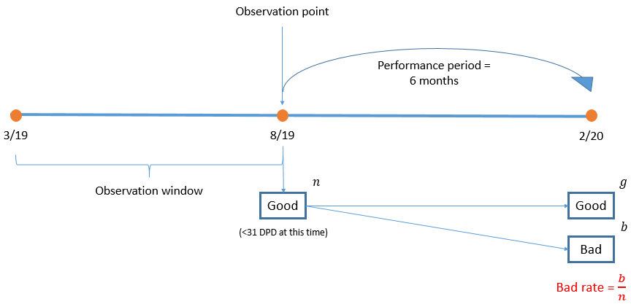
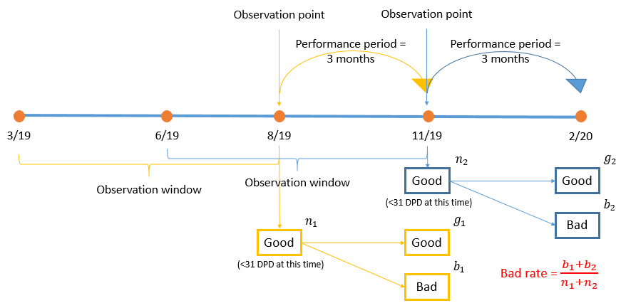
Model Development Sample Design Observation Window/Performance Window/Good-Bad Definition
WCD1
Auto Loans
500 MRMB
Modelling Sample
Mar-19 to Feb-20
With Fallback
Option 1, 6 Months Performance
Option 2, Shortened Performance Period → More Samples
Good and Bad Definition
High Roll Forward Prob.
Roll Rate (Monthly)
1%
38%
66%
86%
DPD | Total (n) | Good (g) | Bad (b) | % bad rate
30+ | 2,050 | 1,987 | 63 | 3.07%
60+ | 2,050 | 2,019 | 31 | 1.51%
Buyback | 2,050 | 2,023 | 27 | 1.32%
DPD | Total (n) | Good (g) | Bad (b) | % bad rate
30+ | 7,965 | 7,857 | 108 | 1.36%
60+ | 7,965 | 7,928 | 37 | 0.46%
Buyback | 7,965 | 7,950 | 15 | 0.19%
DPD
Bucket
0
1-30
31-60
61-90
Buyback
GOOD <= 30 DPD
4,491 obs.
BAD >30 DPD
91 obs. (2%)

Slide 30
Feature Engineering Feature Extraction/Transformation
Raw Factors | Feature | Description |  | New Feature
DPD | max_DPD_LXM | maximum DPD in last X months |  | DLQ_class (Delinquency pattern)
 | count_cure_LXM | number of times that a loan has cured in last X months
 | count_M0_LXM | number of months that have DPD 0 day in last X months
 | count_M1_LXM | number of months that have DPD 1 - 30 days in last X months
 | count_M2_LXM | number of months that have DPD 31 - 60 days in last X months
 | count_M3_LXM | number of months that have DPD 61 - 90 days in last X months
 | count_M1+_LXM | number of months that have DPD >= 1 day in last X months
 | count_M2+_LXM | number of months that have DPD >= 31 days in last X months
 | CurePerM1+_LXM | ratio of count_cure to count_M1+ in last X months
 | first_payment_default_flag | DPD more than 1 day in first payment
 | first_three_payments_default_flag | DPD more than 1 day within first 3 months
Collateral | LTV_current | loan to value at current period |  | LTV_FXY (Future Loan to Value)
Outstanding | act_to_sched_out_current | actual per scheduled outstanding at current month |  | Actual to Schedule Outstanding Pattern
 | act_to_sched_out_LXM | actual per scheduled outstanding at X months ago
Debt Burden | current_debt_burden | installment (include from other banks) per verified income
1
2
3

Slide 31
New Feature 1: DLQ Class
Raw factors | Feature | Description
DPD | current_DPD | current DPD
 | max_DPD_L6M | maximum DPD in last 6 months
 | count_cure_L6M | number of times that a loan has cured in last 6 months
 | count_M1_L6M | number of months that have DPD between 1 and 30 days in last 6 months
 | count_M2_L6M | number of months that have DPD between 31 and 60 days in last 6 months
We have prepared behavioral factor based on delinquency behaviors.
But instead of using them directly, we believe that it is more intuitive that we identify the delinquency patterns and classify them into Qualitative Classes
Pattern Identification
DLQ_class | % 30+DPD
Clean | 0.86%
Forgetful DLQ | 36.84%
Cured Early DLQ | 50.00%
Cured Deep DLQ | 0.00%
Perpetual Early DLQ | 60.00%
Early DLQ | 38.46%
Perpetual Deep DLQ | 100.00%
Increasing Severity
Hypothesis

Slide 32
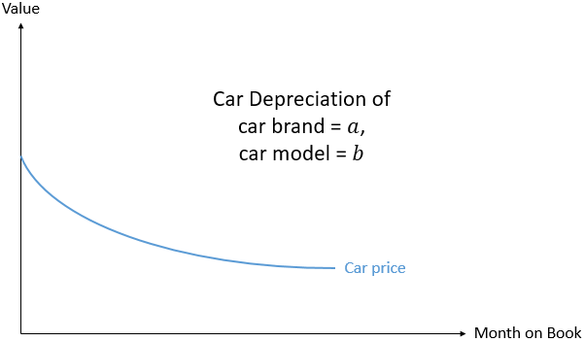
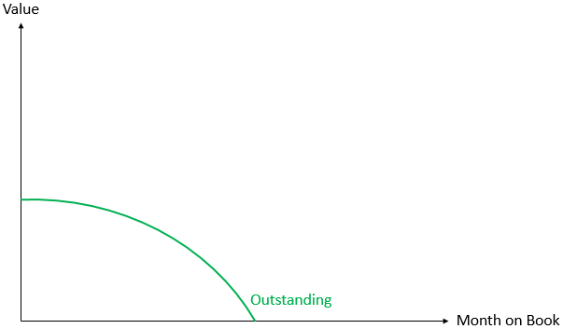
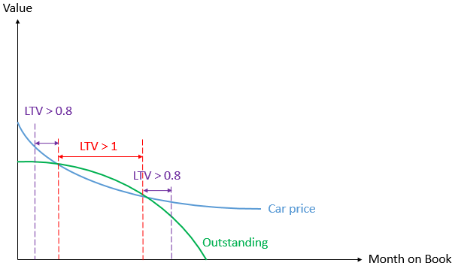
New Feature 2: Future Loan-to-Value
We usually computed LTV only at origination and at any specific time point (current LTV).
However, we hypothesize that future LTV is also important and should be taken into consideration for monitoring portfolio.
Source: https://www.che168.com/
Toyota Yaris | Age (year) | 0 | 1 | 2 | 3 | 4 | 5 | 6 | 7 | 8 | 9 | 10
 | Value (%) | 100 | 71.4 | 64.3 | 56.4 | 50.8 | 44.7 | 39.0 | 32.4 | 28.9 | 23.6 | 20.8
LTV<1: Car value higher than Loan Value
Hypothesis: Lower Chance to Default
Loan amortization
Schedule
LTV>1: Car value lower than Loan Value
Hypothesis: Higher Chance to Default
Bin | Frequency | bad rate
(-∞ , 1.0] | 7245 | 0.73%
(1.0 , ∞) | 719 | 1.28%

Slide 33
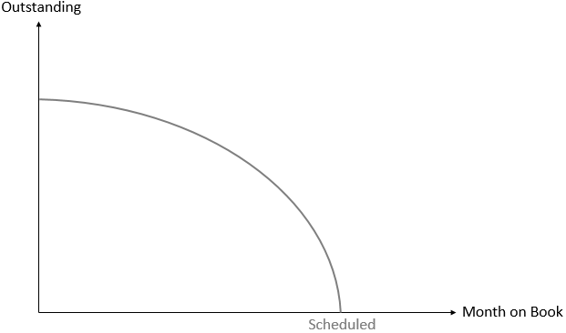
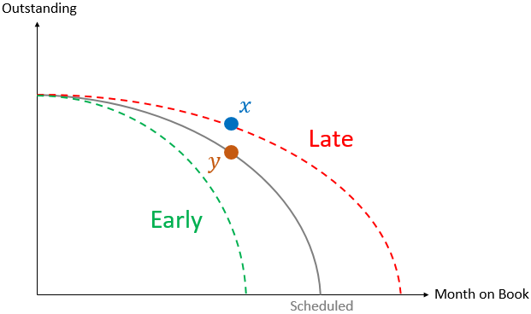
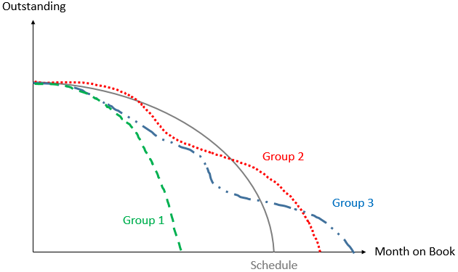
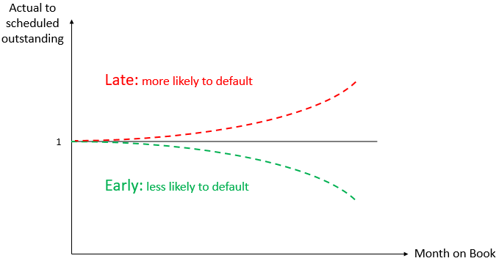
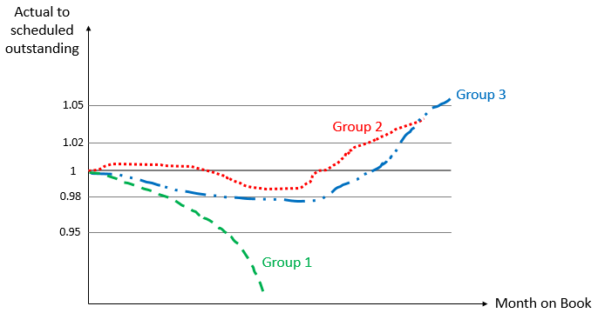
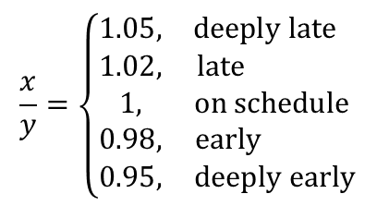
New Feature 3 : Actual to Scheduled Outstanding
DLQ_class is good factor to capture customer’s behavioral pattern.
However, it does not consider effect of month on book and early repayment. So, we might capture customer’s behavioral pattern via loan outstanding instead.
Pattern?
$$\frac{x}{y}=\left\{\begin{matrix}1.05, & deeply late \\ 1.02, & late \\ 1, & on schedule \\ 0.98, & early \\ 0.95, & deeply early\end{matrix}\right.$$

Slide 34
Population
Bad rate
Portfolio Analysis & Insights Data Visualization/Business Sense & Sanity Check
Variable | Correlation with Defaults | IV | Predictive
Delinquency class | + | 1.6774 | strong
Max DPD in last 6 months | + | 1.6290 | strong
Number of cure to number of months that have overdue days in last 6 months | - | 1.6265 | strong
Max DPD in last 3 months | + | 1.5119 | strong
Current DPD | + | 1.3303 | strong
Current Actual outstanding to scheduled outstanding | + | 1.3224 | strong
First three payments default flag | Yes > No | 1.2541 | strong
Actual outstanding to scheduled outstanding 2 months ago | + | 0.6770 | strong
First payment default flag | Yes > No | 0.5238 | strong
Current LTV | + | 0.4660 | strong
Actual outstanding to scheduled outstanding 3 months ago | + | 0.4316 | strong
Future LTV next 1 year | + | 0.3809 | strong
Future LTV next 2 years | + | 0.2693 | medium
Current debt burden | + | 0.2239 | medium
Month on book | + | 0.0490 | weak
+ | The higher the variable the higher the default
- | The higher the variable the lower the default

Slide 35
Final Scorecard Model for Auto Loans
Final Score = 615 + Score1 + Score2 + Score3 + Score4 + Score 5 + ….
# | Variable | Bin Description | Point
0 | Constant |  | 615
1 | Delinquency Class | Missing Value | 0
 |  | Clean | 20
 |  | Forgetful DLQ | 0
 |  | Cured Early DLQ | 0
 |  | Early DLQ | -20
 |  | Cured Deep DLQ | -20
 |  | Perpetual Early DLQ | -40
 |  | Perpetual Deep DLQ | -80
 |  | Rolling DLQ | -120
 |  | NPL | -200
2 | First Payment Default Flag | Missing Value | 0
 |  | No | 0
 |  | Yes | -15
3 | First Three Payment Default Flag | Missing Value | 0
 |  | No | 0
 |  | Yes | -15
# | Variable | Bin Description | Point
4 | Current Debt Burden | Missing Value | 0
 |  | (-∞ , 0.1) | 13
 |  | [0.1 , 0.2) | 7
 |  | [0.2 , 0.3) | -3
 |  | [0.3 , ∞ ) | -7
5 | Current LTV | Missing Value | 0
 |  | ( -∞ , 0.50) | 22
 |  | [0.50 , 0.65) | 12
 |  | [0.65 , 0.80) | 3
 |  | [0.80 , 1.00) | -4
 |  | [1.00 , ∞ ) | -16
6 | LTV next one year | Missing Value | 0
 |  | ( -∞ , 0.50) | 4
 |  | [0.50 , 0.55) | 2
 |  | [0.55 , 0.60) | 0
 |  | [0.60 , ∞ ) | -1

Slide 36
Final Scorecard Model for Personal Consumption Loan
Final Score = 615 + Score1 + Score2 + Score3 + Score4 + Score 5 + ….
Expert Model
# | Variable | Bin Description | Point
0 | Constant |  | 615
1 | Delinquency Class | Missing Value | 0
 |  | Clean | 20
 |  | Forgetful DLQ | 0
 |  | Cured Early DLQ | 0
 |  | Early DLQ | -20
 |  | Cured Deep DLQ | -20
 |  | Perpetual Early DLQ | -40
 |  | Perpetual Deep DLQ | -80
 |  | Rolling DLQ | -120
 |  | NPL | -200
2 | First Payment Default Flag | Missing Value | 0
 |  | No | 0
 |  | Yes | -50
3 | First Three Payment Default Flag | Missing Value | 0
 |  | No | 0
 |  | Yes | -15
# | Variable | Bin Description | Point
4 | Current Debt Burden | Missing Value | 0
 |  | (-∞ , 0.1) | 13
 |  | [0.1 , 0.2) | 7
 |  | [0.2 , 0.3) | -3
 |  | [0.3 , ∞ ) | -7
5 | Consecutive Payback | missing | 0
 |  | (-∞,1.0) | 0
 |  | [1.0,2.0) | -10
 |  | [2.0,3.0) | -80
 |  | [3.0, ∞) | -200
6 | Number Payback L6M | missing | 0
 |  | (-∞,1.0) | 0
 |  | [1.0,2.0) | -40
 |  | [2.0,3.0) | -80
 |  | [3.0, ∞) | -120
7 | Maximum Consecutive Payback L6M | missing | 0
 |  | (-∞,1.0) | 0
 |  | [1.0,2.0) | -40
 |  | [2.0,3.0) | -80
 |  | [3.0, ∞) | -120

Slide 37
Final Scorecard Model for Personal Consumption Loan
Final Score = 615 + Score1 + Score2 + Score3 + Score4 + Score 5 + ….
Expert Model
# | Variable | Bin Description | Point
8 | Consecutive On-time Payment | missing | 0
 |  | (-∞,1.0) | 0
 |  | [1.0,2.0) | 0
 |  | [2.0,3.0) | 10
 |  | [3.0,6.0) | 20
 |  | [6.0,9.0) | 40
 |  | [8.0,11.0) | 80
 |  | [11.0, ∞) | 120
9 | Maximum Consecutive On-time Payment | missing | 0
 |  | (-∞,1.0) | 0
 |  | [1.0,2.0) | 0
 |  | [2.0,3.0) | 10
 |  | [3.0, ∞) | 20
10 | Month on book To Loan term | missing | 0
 |  | (-∞,1/12) | 0
 |  | [1/12,2/12) | -20
 |  | [2/12,4/12) | -10
 |  | [4/12, ∞) | 10

Slide 38
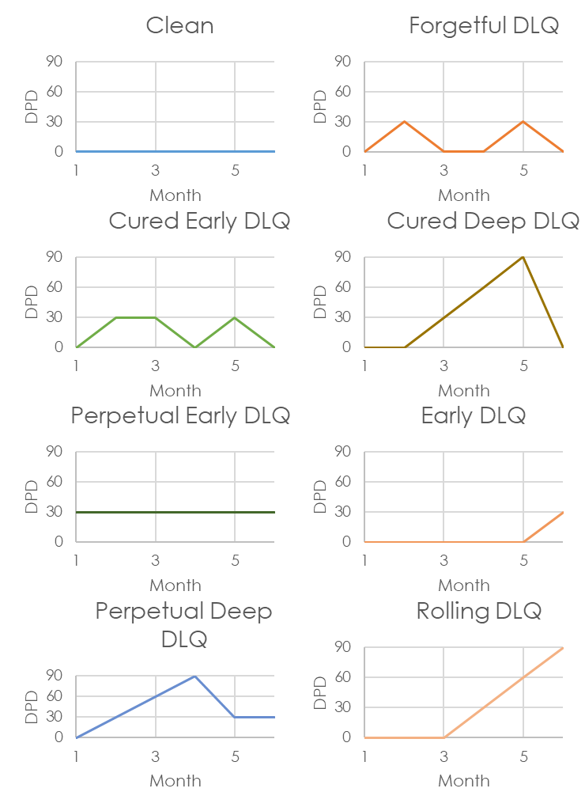
Credit Review & Early Warning Framework
External Credit Scores/ Data
Credit Review & Early Warning
Delinquency Class
Credit Review
Early Warning
RCCR _EXT1
RCCR _EXT2
RCCR _EXT1
Final Credit Grading
(MAX)
DLQ_CLASS | Credit Review Frequency (Month)
Clean | 6
Cured Early DLQ | 3
Cured Deep DLQ | 3
Forgetful | 3
Early DLQ | 3
… | …
NPL | …

Slide 39
Retail Customer Credit Rating
A Unified Credit Rating for Retail Lending in China
RCCR | PD |  | Good | Bad
1 | 0.20% |  | 500 | 1
2 | 0.40% |  | 250 | 1
3 | 0.79% |  | 125 | 1
4 | 1.57% |  | 62.5 | 1
5 | 3.10% |  | 31.25 | 1
6 | 6.02% |  | 15.63 | 1
7 | 11.35% |  | 7.81 | 1
8 | 20.38% |  | 3.91 | 1
9 | 33.86% |  | 1.95 | 1
10 | 50.59% |  | 0.98 | 1
11 | 67.19% |  | 0.49 | 1
12 | 80.38% |  | 0.24 | 1
Mapping from Multiple
Products/Score to a Unified Rating
Auto Loans
A-Score
B-Score
Customer Level
Education Loans
A-Score
B-Score
Double [Good:Bad] Odds
Personal Loans
A-Score
B-Score
Early Warnings
External Score 1
External Score 2

Slide 40
Retail Customer Credit Rating
A Unified Credit Rating for Retail Lending in China
Auto-Loan Credit Approval Model
RCCR | PD |  | Good | Bad
1 | 0.20% |  | 500 | 1
2 | 0.40% |  | 250 | 1
3 | 0.79% |  | 125 | 1
4 | 1.57% |  | 62.5 | 1
5 | 3.10% |  | 31.25 | 1
6 | 6.02% |  | 15.63 | 1
7 | 11.35% |  | 7.81 | 1
8 | 20.38% |  | 3.91 | 1
9 | 33.86% |  | 1.95 | 1
10 | 50.59% |  | 0.98 | 1
11 | 67.19% |  | 0.49 | 1
12 | 80.38% |  | 0.24 | 1
A-Score | Decision | Frequency | % pop | Actual DPD90+
>= 671 | Accept | 513 | 11.20% | 0.23%
636 - 670 | Accept | 1363 | 29.75% | 0.42%
606 - 635 | Accept | 1652 | 36.05% | 0.77%
586 - 605 | Accept | 652 | 14.23% | 1.77%
576 - 585 | Refer | 183 | 3.99% | 2.21%
561 - 575 | Reject | 156 | 3.40% | 5.18%
546 - 560 | Reject | 39 | 0.85% | 11.84%
521 - 545 | Reject | 22 | 0.48% | 18.37%
501 - 520 | Reject | 2 | 0.04% | 28.86%
481 - 500 | Reject | 0 | 0.00% | #DIV/0!
461 - 480 | Reject | 0 | 0.00% | #DIV/0!
<= 460 | Reject | 0 | 0.00% | #DIV/0!
Double [Good:Bad] Odds
Maintenance (Yearly Validation & Calibration)
Model Development Sample

Slide 41
Auto-Loan B-score Mapping to RCCR
RCCR | PD | ODD |  | Bin | Frequency | % pop | Actual DPD30+ | Expected DPD90+
1 | 0.20% | 500 |  | >= 646 | 2261 | 28.39% | 0.27% | 0.15%
2 | 0.40% | 250 |  | 636 - 645 | 2365 | 29.70% | 0.55% | 0.32%
3 | 0.79% | 125 |  | 631 - 635 | 1166 | 14.64% | 0.87% | 0.50%
4 | 1.57% | 62.5 |  | 626 - 630 | 1015 | 12.74% | 1.70% | 0.97%
5 | 3.10% | 31.25 |  | 616 - 625 | 1016 | 12.76% | 2.11% | 1.19%
6 | 6.02% | 15.63 |  | 606 - 615 | 59 | 0.74% | 9.26% | 4.89%
7 | 11.35% | 7.81 |  | 581 - 605 | 28 | 0.35% | 55.56% | 20.62%
8 | 20.38% | 3.91 |  | 571 - 580 | 22 | 0.28% | 22.22% | 10.50%
9 | 33.86% | 1.95 |  | 551 - 570 | 20 | 0.25% | 150.00% | 34.64%
10 | 50.59% | 0.98 |  | 531 - 550 | 9 | 0.11% | 350.00% | 44.90%
11 | 67.19% | 0.49 |  | 501 - 530 | 3 | 0.04% | #DIV/0! | #DIV/0!
12 | 80.38% | 0.24 |  | <= 500 | 0 | 0.00% | #DIV/0! | #DIV/0!

Slide 42
ERM – WBG – KBANK China
Retail Lending Special Project
Agenda 4: Risk Infrastructure Phase 2

Slide 43
1
Phase 1
Future
炜机 Risk Engine: High Level Architecture
Phase 2
Microservices
Risk Engine
Approval [Online]
Daily
Monthly
BMPOC
PAOC
CUP
WCD
AiBank
PAOC
CUP
KORPS
Payment Reminder
Billing
Loan Daily Reports
EXT Data REQ
RISK Engine
API Modules
[KBTG]
Rebate Engine
[IM]
INT Data REQ
Daily Analytics
Engine
[IM]
Manual Approval
Monthly Analytics
Engine
[IM]
Online Risk Engine (Loan App.)
[IM]
LIVE
Daily Monitoring
Collection
10%
80%
Risk Engine Data Areas
App-in DB
Daily Analytics
Reports
Monthly Analytics
Reports
Notes:
Loan daily report มันแยกส่วนยอด outstanding มั้ยว่า อยู่กับ Bank เราเท่าไหร่ อยู่กับ partner เท่าไหร่
เพิ่ม Flexcube Loan daily report หน่อย
ในdata analytics engine นี่เก็บข้อมูลเป็น cust หรือเป็น account
Collection ต้องมีส่งข้อมูลเตือนลูกค้า จะส่งเตือนช่องทางไหน ต้องผ่าน cupd หรือส่งตรง การคำนวณ Provision คำนวณนอกระบบนี้

Slide 44
1
Phase 1
Future
炜机 Risk Engine: High Level Architecture
Phase 2
Risk Engine
KORPS
BMPOC Front End
Approval [Online]
BMPOC
PAOC
CUP
External Data
PAOC
IceKredit
Override Input (HTML form)
KORPS
Email Alert
UNION PAY ADVISOR
Wiseco
Manual Override
EXT Data REQ
RISK Engine
API Modules
[KBTG]
Bairong
PBOC
OVR Data Request
Risk Engine API Module
INT Data REQ
Data Management
PAOC
Output Manage-ment
App-in DB
…
Manual Approval
App-in DB
Decision Engine
Controller
Income Estimation
Debt
Estimation
DB Write
Online Risk Engine (Loan App.)
[IM]
Internal Data Request
Credit
Decision
Segmentation
Credit
Policy
Credit
Scoring
CAR
Anti Fraud?
PAOC
…
…
Champion Challenger
Credit Limit
Credit Grading
Pricing

Slide 45
1
Phase 1
Future
炜机 Risk Engine: High Level Architecture
Phase 2
Risk Engine
Daily
WCD
CUP
PAOC
AiBank
BMPOC
WCD
AiBank
PAOC
CUP
Loan Daily Reports
Delinquency Reports
Customer Info.
Loan Daily Reports
1_0 Data Processing
5_0 DB Write
Visual Analytics Tools
RAW
Daily Analytics
Engine
[IM]
Daily Analytics
Engine
[IM]
4_0 Reporting
2_0 Segmentation
Auto Scheduling /Readiness Check
Collection Performance Report
Collection Analytics
Daily DLQ Report
Reports
Credit Scoring
(Collection Score)
3_0 Collection Strategy & Action
Daily Monitoring
Collection
Daily Portfolio Monitoring
Credit Grading
3_1 SMS Reminder
3_2 Collector Notification
Daily Analytics
Reports
Claim Report & Buyback Filing
Others Auto Call etc.

Slide 46
1
Phase 1
Future
炜机 Risk Engine: High Level Architecture
Phase 2
Risk Engine
Monthly
WCD
CUP
PAOC
AiBank
BMPOC
Payment Reminder
Billing
Loan Daily Reports
Billing
Rebate Engine
[IM]
Data Processing
Payment Reminder
Monthly Analytics
Engine
[IM]
Rebate Engine
[IM] BMPOC
Loan Daily Reports
Credit Performance
Factor Creation
Monthly Analytics
Engine
[IM]
Credit Review
Vintage
Reporting
External Data Req
Roll rate
Monthly Analytics
Reports
Early Warning
Credit Scoring
(B-Score)
Monthly Analytics Data
Monthly Analytics
Reports
Final Grading
2_1 Credit Grading

Slide 47


